Slide 1
MINECOFIN Quarterly Macro-Fiscal Model (QMFM)
Quarterly Macro-Fiscal Outlook (QMFO)
Summary Outlook 2024-27
Nov 2024 Round

Slide 2
Outline/contents
Glossary of key terms and acronyms
Recent macroeconomic developments
Macroeconomic forecast assumptions
Macroeconomic forecast/outlook
Forecast evaluation (forecast comparison)
Model revision—Effect of recalibration
QMFM interrelation with the macro toolbox (nowcasting, MF)

Slide 3
Glossary of key terms and acronyms
QMFM: Quarterly Macro Fiscal Model
FPAS: Forecasting and Policy Analysis System (FPAS)
ER: Exchange Rates
RER: Real Exchange Rates
RIR: Real Interest Rates
NTF: Neal Term Forecasts
LT: Long Term
G&S: Goods and Services
YoY, %: Year on Year Percentage Change
IMF: International Monetary Funds
WEO: World Economic Outlook
GAS: General Assumptions
GEE: General Economic Equilibrium
CBO: Central Budget Office
PCI: Policy Coordination Instruments
NISR: National Institute of Statistics of Rwanda
NA: National Accounts
IB: Interbank Rates
BNR: National Bank of Rwanda
intMF: intergrated Macroeconomic Framework

Slide 4
I. Glossary of key terms and acronyms
Output gap & final demand gaps (+/-): above/below potential or trend levels
Real interest & real exchange rate gaps: RIR and RER above/below neutral or equilibrium levels
Decomposition of macro aggregates by main drivers: coloured bars in charts show contribution of each
Fiscal deficit relevant for demand impact: deficit before grants = total expenditure -/- non/tax revenue
Debt anchor & sustainable deficit: debt ratio to GDP target (with LT growth, inflation rates, etc.) drives sustainable debt-creating deficit.
Fiscal stance expansionary/contractionary: deficit and govt demand G&S in % of GDP above/below trend levels (i.e., “discretionary” deficit and “discretionary” govt demand for G&S in % of GDP above/below zero)
Fiscal impulse (on private demand): mainly discretionary fiscal deficit affecting consumption & investment (via income, ‘optimism’)
More/less restrictive monetary policies: (real) interest rates above/below neutral or trend levels
More/less restrictive exchange rate policies: real exchange rate below/above equilibrium or trend level
Role of expectations: agents today take into account expected macro variables and policies in periods ahead (e.g., expected inflation, exchange rate, final demand gaps,…)
Forward-looking: period ahead behavioural expectations/speculations (+1 or +4 Qos)
Persistence: lag or effect of previous/initial values or behaviours
Trend: An estimated smoothed level or set target defined as a potential or steady state level to which variable converge in absence of shocks
Gap: Deviation from trend or target level
Shock: All other factors not captured by model equation or parameter specification
Unobserved and observed variable: Estimated or calculated in the model and computed from actual data respectively
Decompositions (level, growth rates and % of GDP): For gap variables, decompositions expressed in gap form, for growth variables expressed in growth rates (sum of components equals total).

Slide 5
II. Workings of underlying QMFM model
Macro model is New-Keynesian, ‘semi-structural gap’ of the Forecasting and Policy Analysis System (FPAS)
Provides forecast quarterly forecast for key macro variables (i.e., output gap, inflation, final demand components,..) as influenced by fiscal, monetary, and exchange rate policies (policy stances), incl. in response to shocks and new developments
emphasis on fiscal variables & deficit components (revenue, govt spending & structural, discretionary, cyclical components)
impact of fiscal and monetary policies inflation, and other macro aggregates on GDP (demand/output gap)
tracing key macro variables(levels) in deviation from trends, potential levels, or targets:
Economic developments
Analysis of observed data to examine the drivers of the patterns in macroeconomic variables.
Estimation of unobserved variables (gaps and trend)—How model fits and explains the history/past developments
Analysis of Initial conditions or recent developments to understand the drivers of the business cycle and trend
Assumptions—i.e., policy stances, policy paths (deficit, interest rates, and ER), NTF, and external/foreign position.
After shocks and policy responses have worked out, variables return to their trends/potential levels (subject to persistence) determined by their steady-state levels
Forecast simulation as a function of initial condition, policy stance, NTF, and LT policy assumptions
Analysis of the forecast of gaps and trends in short-run

Slide 6
III. Rationale of outlook & underlying QMFM model
Regular forecasts with a 16 quarters horizon at quarterly frequency for a large number of macro variables (i.e., output, inflation, final demands,..) as influenced by developments in fiscal, monetary, and exchange rate policies.
Forecasts focusing on fiscal and financing/debt variables, and interaction with monetary and exchange rate policies
Providing input for the validated macro-fiscal projections underpinning (medium-term) budgets and IMF-supported programs, complementing the intMF (Real sector-GDP supply proj.) and other macro-projection tools.
facilitating policy coordination between MINECOFIN and NBR; IMF mission preparation; and policy debate
simulating alternative policy scenarios, and analysing policy implications for making policy recommendations

Slide 7
IV. Recent macroeconomic developments (2015-2023) Final demand: Gross Domestic Product
Output gap drivers
Covid years (2020-21)
consumption and investment accounted for most of the GDP drop and negative output gap
fall in imports and expansionary government demand helped mitigate the downpull on GDP;
Immediate post-Covid (2021-22)
consumption and investment contributed most to the recovery
supported by continued government demand, while exports remained sluggish
Ukraine-war (2022-23)
post-Covid recovery slowed down due to jumps in international oil and food prices, causing high inflation and drop in real consumption and other demand
fiscal consolidation started (though in part thwarted by floods) and lowered the expansionary effect of govt demand
Real GDP (YoY %)
trend growth (2000-19) averaged 7.5%
in COVID year 2020, GDP dropped 3.4% and was 12% below potential (had trend growth continued) due to drops in external and domestic demand and supply constraints
expansionary fiscal policy mitigated COVID output drop and helped subsequent recovery
global instability, esp. Ukraine-war slowed down the recovery from 2022Q1 onward
despite a strong bounce back in 2021, GDP estimated 6% below potential in late 2023

Slide 8
Prices: Inflation—Consumer Price Index (CPI)
Headline CPI—drivers (left chart)
Covid years (2020-21)
above target during 2020 induced by higher COVID-related food and core prices (imports)
Immediate post-Covid (2021-22)
lower, driven by a still sluggish economy, good agricultural harvests, and less expensive imports
Ukraine-war (2022-23)
sharply increasing food prices: driven by negative agricultural production gap and other supply shocks
sharply increasing world energy and commodity prices
higher core prices: expectations, import prices (in/direct), supply-side shocks (pricing behavior not captured in the model)
deceleration observed in core and food inflation and fall in energy from 2023Q1.

Slide 9
Fiscal policies—deficit and its components
Fiscal deficit (before grants, % GDP, GFS-1986) and Govt demand (%GDP)
Some fiscal consolidation pre-Covid—slightly lowered deficits averaging 10% of GDP in 2015/16—2018/19, mainly through lower spending on G&S (“discretionary”)
Expansionary fiscal stance under Covid—increased deficits averaging 14% of GDP in FY2019/20—2021/22, mainly Covid-related spending on G&S (incl. school construction) and transfers/subsidies, mostly “discretionary” spending and deficit, only small “cyclical” deficit
Start of fiscal consolidation post-Covid—deficit declined to 12% of GDP in FY2022/23, with spending on G&S falling by 3% points of GDP (despite flood-related spending)
Fiscal stance entailed a sharp drop in real govt demand for G&S, further exacerbated by surging inflation from early 2022 before falling in 2023

Slide 10
V. Forecast assumptions Current cyclical position, policy stance & external environment
External (exogenous): September 2024 IMF WEO-GAS/GEE and CBO US RIR projections
Domestic: NBR’s monetary (IB-rate), fiscal (deficit path) and ER policy stance and inflation (CPI) position.
Real GDP/ Output: Near Term Forecasts (NTF)—Nowcasting.
IR and ER policy stance: A less tight monetary policy following easy inflation in 2024 (i.e., 7.5% IB rate for Q3)
ER: Q3 and Q4—IMF BNR prog 2024 depreciation path i.e., 2024Q4 assuming % ann. depreciation of 9% by 2024 (end-June)
ER (s) 2024Q3 (Obs. July & Aug and Sept as eop 28th Sept) tuned as average of 3 Months
Baseline fiscal policies: Fiscal deficit as in PCI 2023/24-2025/26 IMF Program (March 2024 Projections)
Post-PCI program: return to the previous path of gradually moving toward a sustainable deficit of 5% of GDP (7.5% excl. grants) rather than 3% as in the post-PCI IMF Program
Govt revenue and exogenously taken as per the path agreed upon in the IMF PCI program.

Slide 11
External environment assumptions
Rwanda still enjoys recovery in trading partner demand relative to Covid-years, at 3% p.y., well above the trend
World economy slowing down as interest rates are raised in response to inflation before catching up since 2026
World real interest rates are expected to rise from negative around -1% in the past decade to +1% by 2027,
increase likely transmitting one-for-one to Rwanda’s sovereign borrowing rates
trading partners’ CPI inflation (in US$)—subdued at 1.5% p.y. in the past 5-7 years
projected to return and remain below trend level of 2% in the coming years
overall outlook is improving after the Covid and Ukraine shocks, but with downside risks.

Slide 12
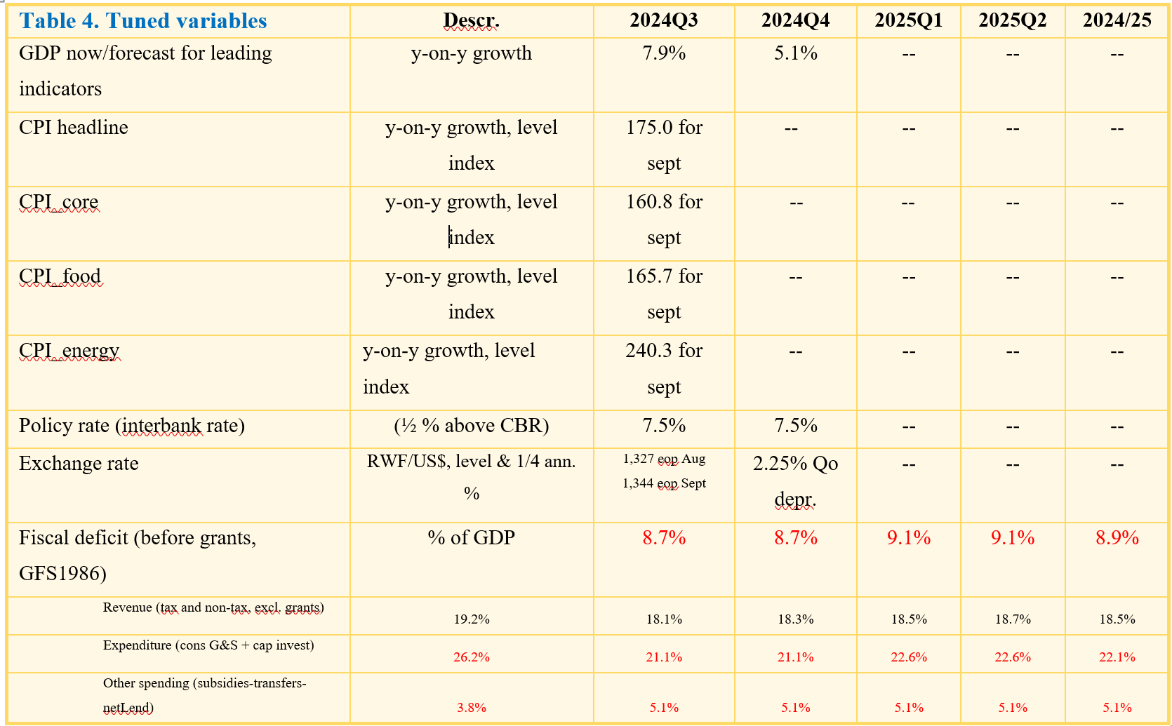
Domestic environment assumptions
NT forecast and policy stance driving Novemeber. 2024 forecasts:
Fiscal consolidation: deficit before grants ‘set’ at PCI targets of 8.9% for 2024/25 and 7.5% for 2025/26
beyond PCI, deficit (before grants) driven by fiscal anchor determined by target debt/GDP ratios, that is a sustainable level of 8% of GDP
Policy interest rate (IB): maintained at 6.5% for 2024Q4; thereafter: follows policy interest rate (IB) rule
Exchange rate (ER): current-year PCI-program targeted annual depreciation: ER path in 2024 set to 9% y-on-y in Oct 2024
GDP: set to “now/forecasting” for Q3&4 2024 (i.e., 7.9% and 5.1% for Q3 & Q4 2024)
Inflation (CPI): 2024Q4 (Sept 2024 as an average of observed for July & Aug index)
Agriculture production: Good season A&B of 2024 resulting in easing of domestic food price shocks
note: 2023/24 and 2024/25 Budget deficits and spending on G&S have been tuned based on the semester breakdown of annual figures (because the projected quarterly breakdown is not available), hence quarters are the same within the semester
Data expert judgement: given persistent and new anomalies observed in NISR NA final-demand data (i.e., overshooting imports, exports and inventories) for 2023Q3-2024Q2
Suppression of NA data and replaced by model estimates to get plausible initial conditions (i.e., GDP trend) for the forecast simulation.
Observed data ranged 2006Q1-2024Q2, and forecast simulation ranged 2024Q1-2027Q4, implying that data for 2024Q1&2 was used for forecast as it was observed.
Notes:
The QMFM sustainable debt-creating deficit is 5% of GDP under assumptions of: debt/GDP target of 55% (45% in NPV terms, o/w 10% domestic and 35% foreign debt, grant element 22%), real GDP growth 7.5% p.y., trading partner inflation 2% p.y., and trend RER depreciation rate 0%. The structural deficit consists of revenue 21%, government consumption 13%,government investment 11%, and other spending 5% of GDP.

Slide 13
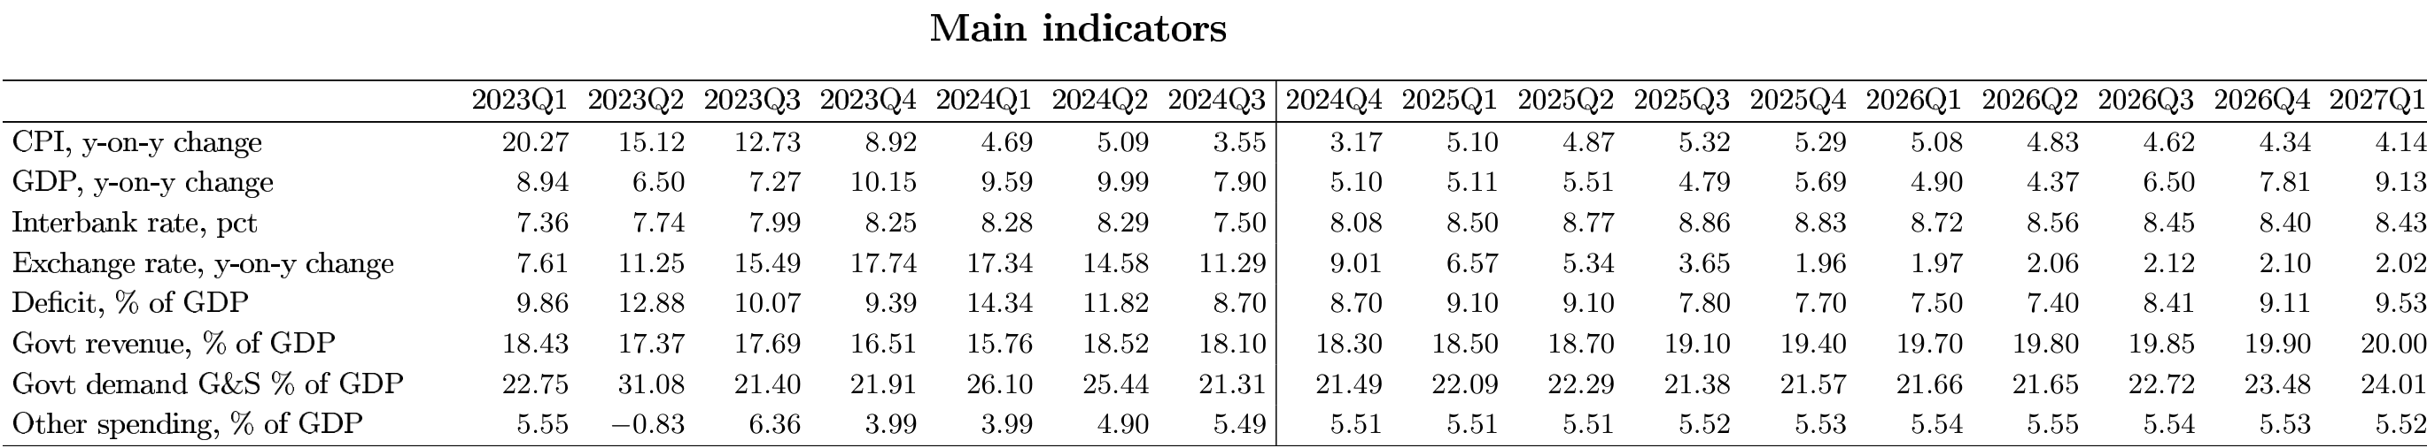
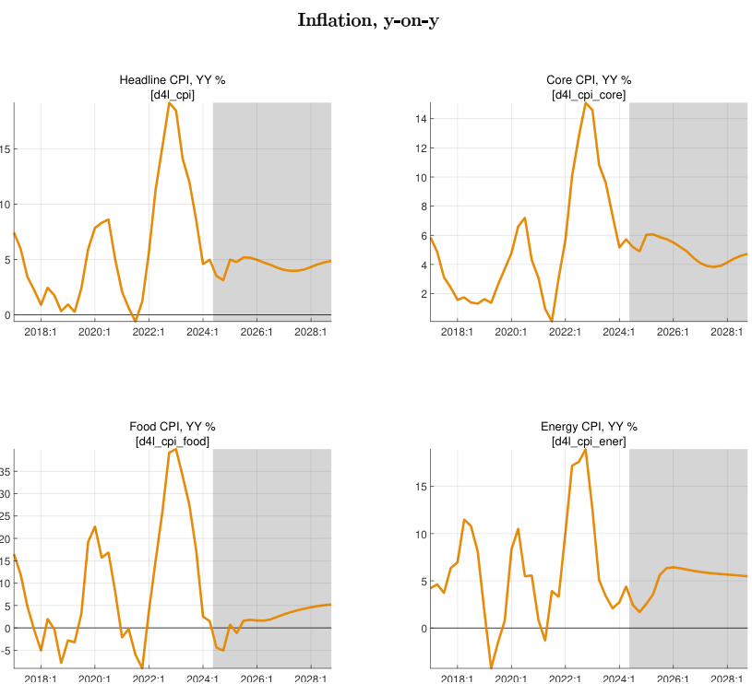
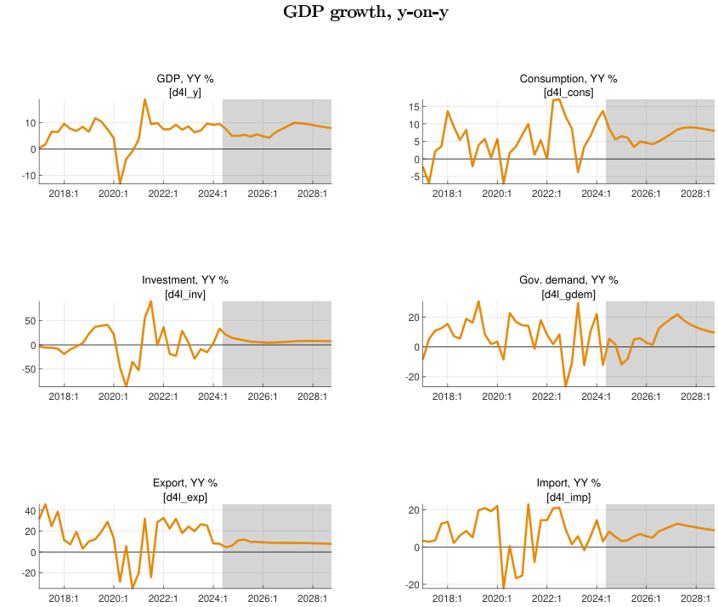
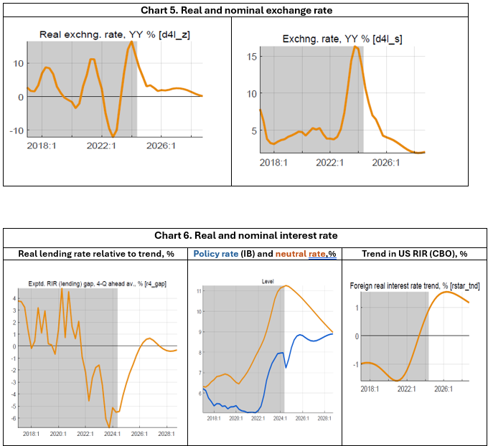
VI. Macroeconomic forecast/outlook Real economy—Key macro-aggregates
real GDP is forecast to slow down markedly in 2025-26, well below potential growth, followed by a catch-up (a bit above potential) in 2027-28, before returning to the regular growth path of 7½%.
Cyclical demand position: output still below potential level (negative output gap) between 2024-2027
GDP growth in 2024 is forecast at 7.8% despite a slowdown to 5% for 2024Q4, given robustness earlier in 2024.
Growth so far in 2024 was helped by a still low RIR and still modest fiscal restraint.
The slowdown in 2025-26 is driven by:
contractionary effect of strong fiscal consolidation, both directly as govt demand for G&S falls, and indirectly through the negative fiscal impulse on private demand
negative impact on demand of increased RIR as the real lending rates return to normal
slightly offsetting positive, but lagged effect on net exports of recent and further RER depreciation
Catch up in 2027-28 is driven by:
end of fiscal consolidation (Govt demand pick up), the negative fiscal impulse stops
end of increase and the start of a slight decrease in RIR
positive impact of more depreciated RER (some undervaluation)

Slide 14
Real economy—Prices & market rates
2. CPI is forecast to be subdued, below 5% through 2027, followed by a gradual return to target 5%
The y-o-y and period average CPI in 2024 should be below 5%, helped by a recent drop in food prices, a reversal in 2023-24 of earlier positive price shocks, and expectation of lower inflation thanks to demand-restraining policies.
The CPI well below 5% in 2025-27 is driven by:
effect of increasing RIR and large negative fiscal impulse on demand, hence output
continued drop in food prices as agriculture returns to normal
still low trading partner prices, and a small drop in world energy and food prices
somewhat offset by the CPI-increasing effect of NER depreciation on import prices
The return to the target CPI from 2028 onward is driven by:
govt demand pick up (as consolidation stops post-PCI)
other demand components return to normal
interest rate policies push inflation back to target
3. Final demand: private demands are forecast to slow down in 2025-26, returning to normal thereafter
Real consumption: after above-trend growth in 2023/early 2024, restrictive policies lower real consumption growth to +4% in 2025-26, before it returns to trend growth in line with GDP (7.5%)
Real investment: after sluggish growth in 2022-23, growth is forecast to be strong in 2024 (above 10%), slowing down to +6% in 2025-26 as real lending rates increase; then moves to trend growth
Real exports: after above trend growth in 2023-24, export growth slows down but gradually as the positive effect of recent RER depreciation keeps export growth above trend the whole period
Real govt demand: almost no growth in 2025-26 due to fiscal consolidation, strong pickup thereafter
Real imports: follow other demand components (including govt demand)
6. RIR lending rate: expected to go up to normal (around 12%, for 8% margin above IB rate), but remain above pre-Covid level as world RIR projected to reach 1.5% (from negative in recent years)
RIR lending rates have been low (below trend) during most of 2022-24 though they have been rising in recent quarters (as inflation fell)
as they are now returning to normal, their demand-stimulating effect is ending and reversing
the neutral policy (IB) rate—after a temporary drop with low inflation--is expected to go up to 8.5-9% (and 4-4.5% in real terms) as world RIR increases and CPI inflation returns to target
5. ER: returns gradually to a path of only correcting for inflation differentials (2% py)
recent real overvaluation (mostly from 2022-23 inflation episode) has already been more than corrected with NBR's 2023-24 steep depreciation
QMFM projects return to ER policy rule (mostly moving with inflation differentials), no need for further RER depreciation
PCI, instead, "poses" lingering overvaluation of 15% (which evidence?) requiring more depreciation, as built into PCI projection 2024-28

Slide 15
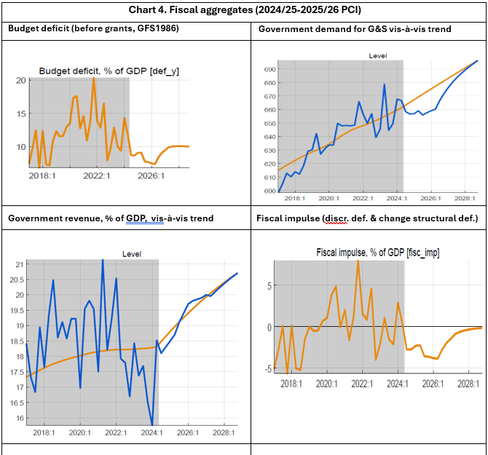
Fiscal policy: govt demand for G&S and fiscal impulse
Fiscal policies affecting output in short-run via several channels captured in the model:
--from 2024, govt demand % GDP switches from above to below its structural trend
--implies negative govt demand for 2023-25, fading thereafter
4. Fiscal path assumed: PCI targets FY2024/25-2025/26 for deficit, revenue, and spending are set
negative govt demand and fiscal impulse entail a growth slowdown in 2025-26
From late 2026, the negative fiscal impulse ends, deficit moves back up toward a sustainable path
the beyond-PCI sustainable fiscal ratios toward, rev/GDP 24%, govt-dem G&S 26%, other exp 5.5% grants 2.5% and debt-creating deficit 5% of GDP (consistent with 45% NPV public debt)
esp. as revenue is slow to rise, debt-creating deficits are for a few years above sustainable, at 7%.
Notes:
See Output gap and Fiscal Impulse in last Chart

Slide 16
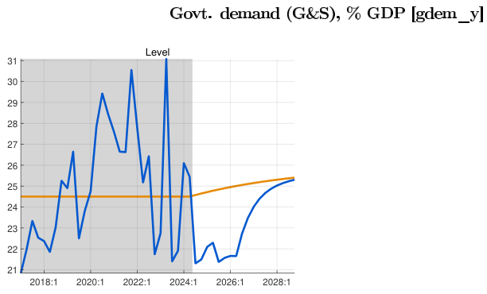
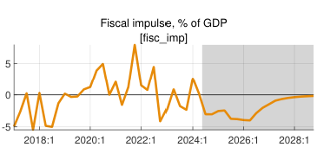
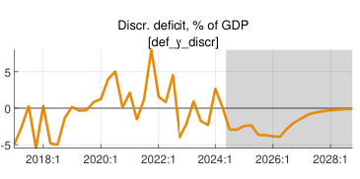
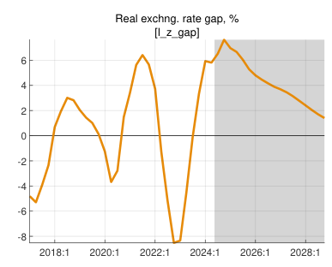
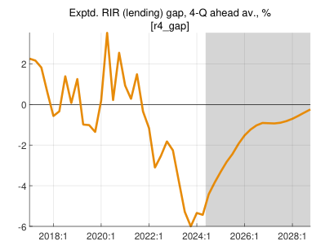
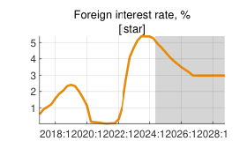
VIII. Policies guiding forecasts
Real Output growth:
Slowdown in 2025-26:
Fiscal policy: expansionary fiscal policy—strong fiscal consolidation i.e, tight govt demand for G&S falls, and negative fiscal impulse on private demand)
Monetary policy: Tight Real Interests Rate contract demand
Exhange rate: further RER depreciation to negatively affect net exports.
Catch up in 2027-28:
Fiscal policy: contractionary fiscal demand—end of fiscal consolidation (Govt demand pick up)
Monetary policy: Expansionary Real Interest Rate
Exchange rate: Positive impact of more depreciated RER to exports

Slide 17
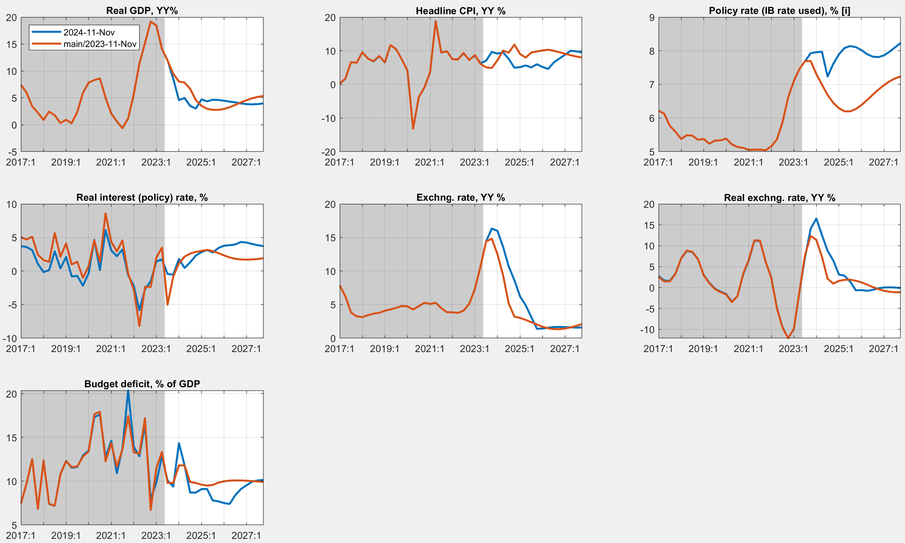
VII. Forecast evaluation (latest vs. new forecast)
Main indicators
Nov 2024 vs. Nov 2023 forecast
Effect of new observed data/info
More responsive policy and real interest rates on inflation (recalibrated reaction of IR on inflation)
More overvalued Exchange Rate (ER)—A higher ER depreciation
CPI turning to target and more accelerated post 2026
A lower budget deficit—more consolidated fiscal policies
Lower GDP growth due to tight monetary and fiscal policy

Slide 18
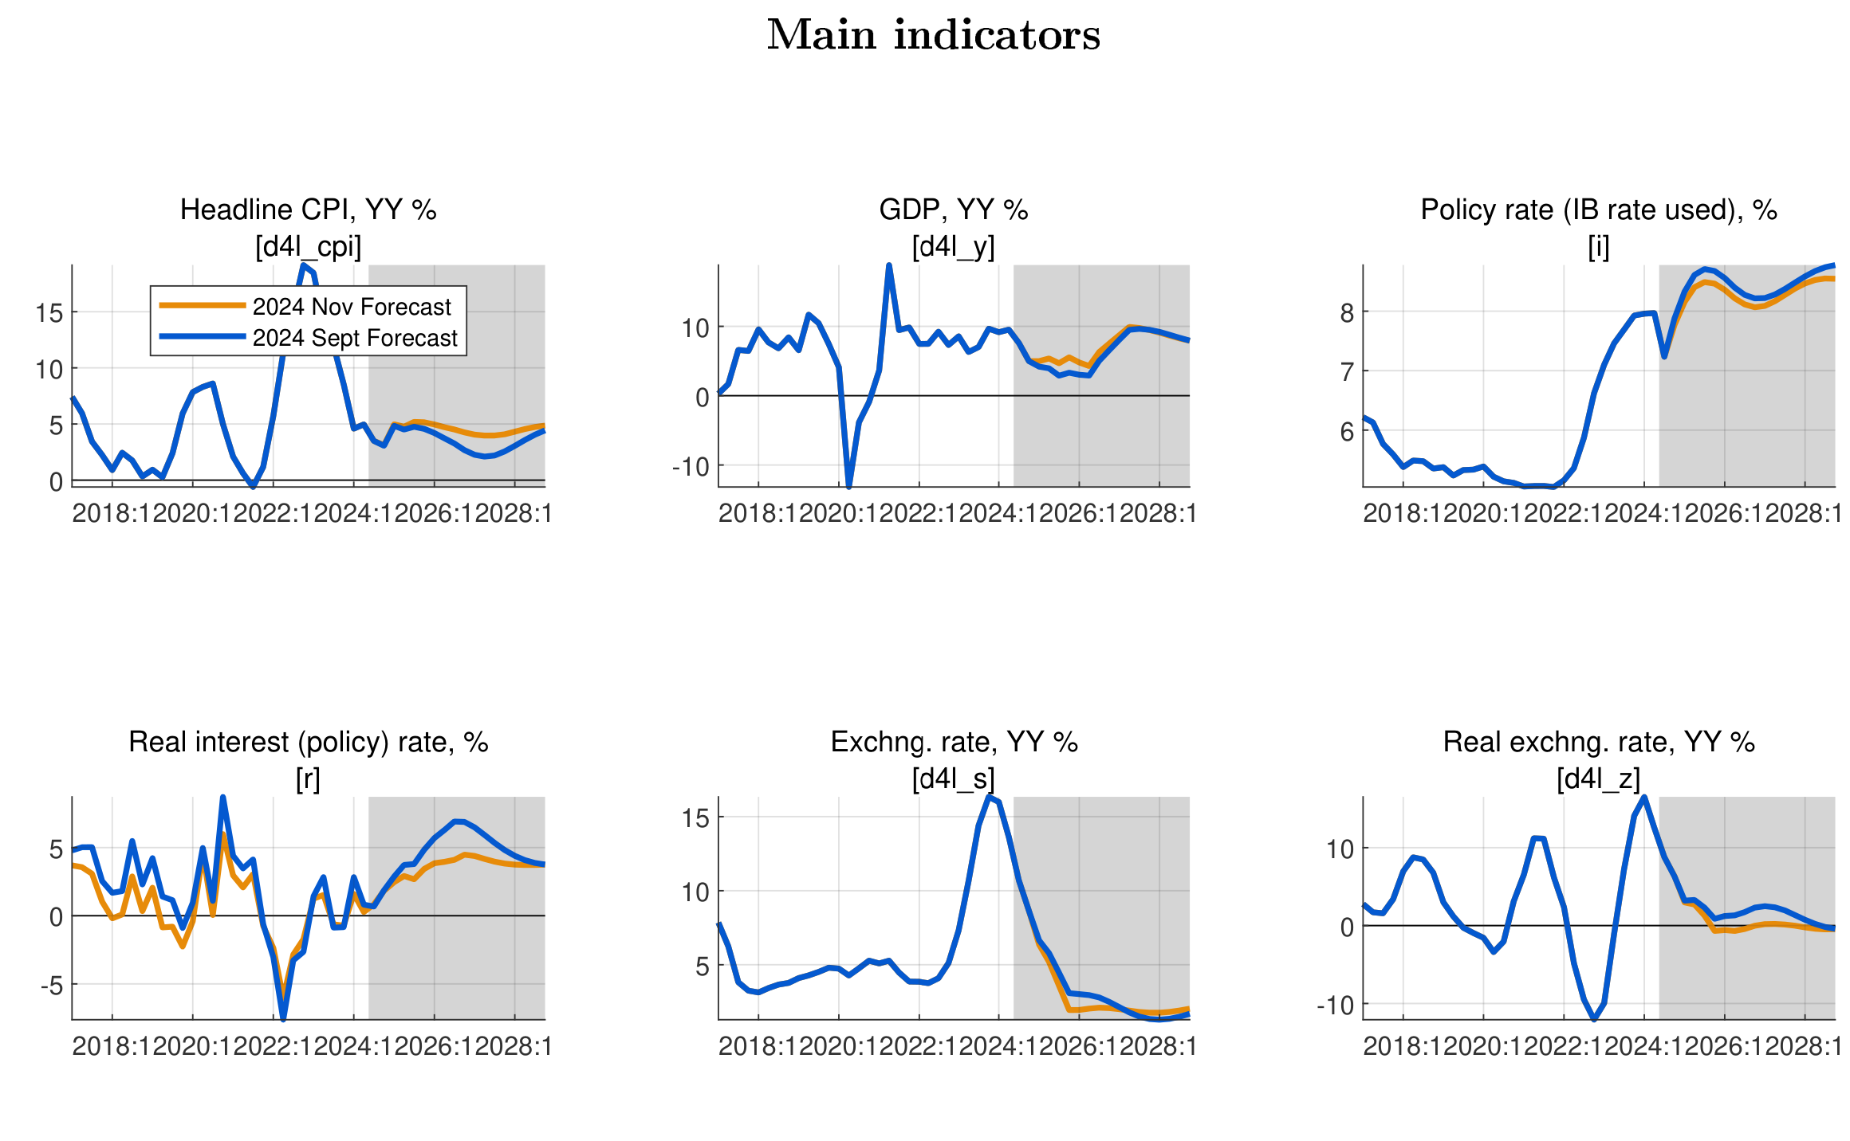
VIII. Model revision—Effect of recalibration)
Main indicators
Nov 2024 vs. Sept 2023 forecasts
Effect of parameter recalibration (Incl. IB rate response to inflation and output gap, UIP and Core CPI persistence)
More responsive policy and real interest rates on inflation (recalibrated reaction of IR on inflation)
A less overvalued Exchange Rate (ER)—A less ER depreciation
CPI turning to target and more accelerated post 2026
Higher GDP growth due to less tight monetary policy.

Slide 19
IX. QMFM inter-twin with macro toolbox (nowcasting, MF…)
Calibration of elasticities and exogenous assumptions (i.e., exogenous growth rates of final demand components)
During IMF Mission and Projections reviews (March) QMFM quarterly GDP estimation is useful to inform Real sector/MF Inyear projections.
Quarterly estimation of GDP from demand side can be used to evaluate quarterly nowcasts
Notes:
See Output gap and Fiscal Impulse in last Chart

Slide 20
THANK YOU

Slide 21
X. Data issues and requests & suggestions
Model/Outlook data issues to be addressed
intMF – fiscal: accurate govt demand for G&S, more timely and reliable Q data, timely Q treasury plan
– debt: timely & complete Q data (showing IMF separately) and projections integrated into intMF
NA/NISR – discrepancies/anomalies Govt consumption, investment, inventories, final demand deflators
NBR – more timely Q BoP data, as input for models and intMF
NBR-FPAS results, analysis of potential output, international interest rates (GPM)
WEOGAS & GEE in right format– timely sharing by IMF staff, QoQ projection instead of YoY
timely data reconciliation and iterative comparison of forecast results from various tools
input for intMF well before each Review and each quarter
Notes:
MINECOFIN can have a different assessment of path and impact of monetary and ER policies than NBR, just as NBR can have a different assessment of path and impact of fiscal policies.

Slide 22
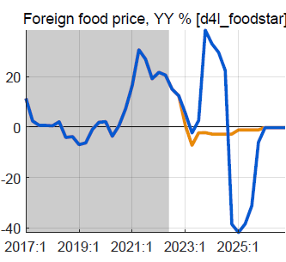
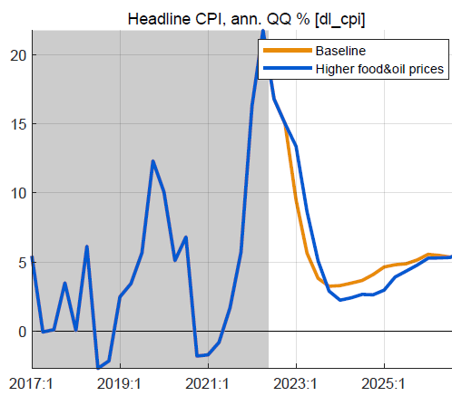
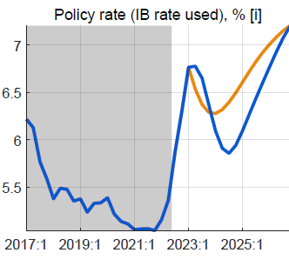
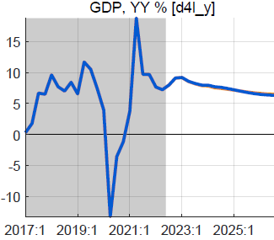
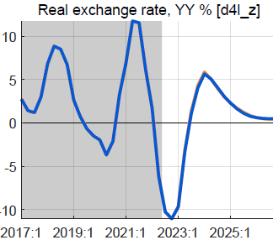
XI. Alternative scenario: higher foreign food/oil prices (2023-24)
Higher-than-WEO foreign food and oil prices in 2023-24
foreign food and oil prices on average 25% higher than BL
with peak around end-2023, return to WEO levels from 2025
no change in fiscal policy
Results in higher headline CPI, little or no effect on output
headline CPI temporarily higher, reflecting food/oil import shares
small response policy rate, reversed fast as expected inflation drops
small positive effect on demand of lower RIR
mostly offset by negative effect of slightly more appreciated RER
overall effect on GDP is very small, less than 0.2%

Slide 23
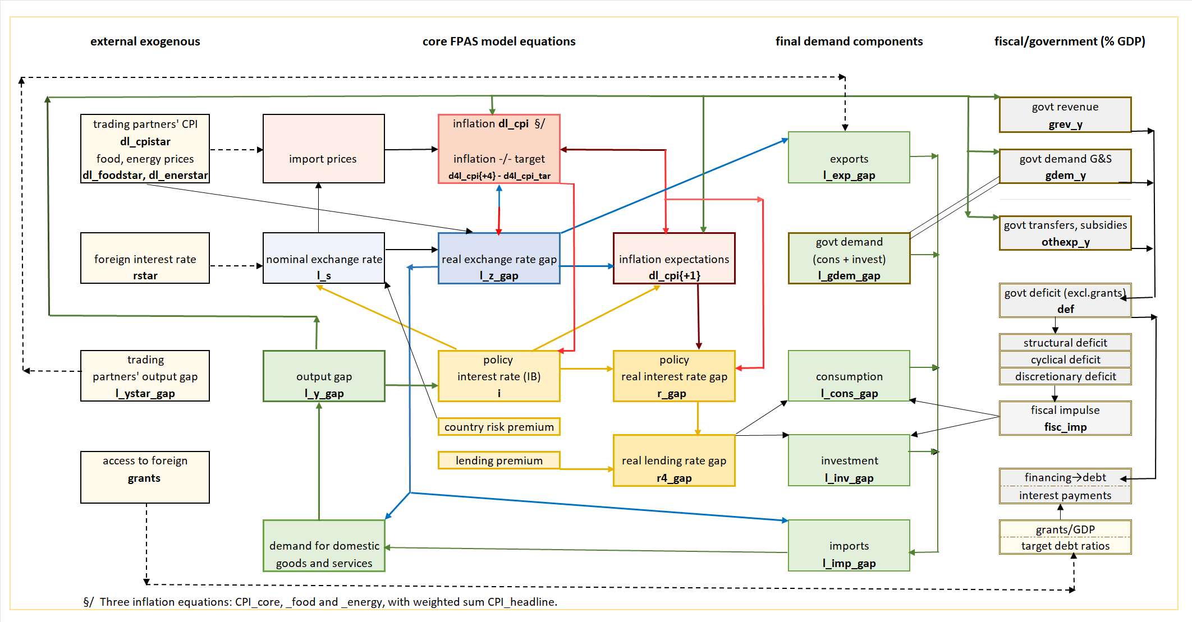
VIII. QMFM: main relationships and transmission mechanisms

